Slide 1
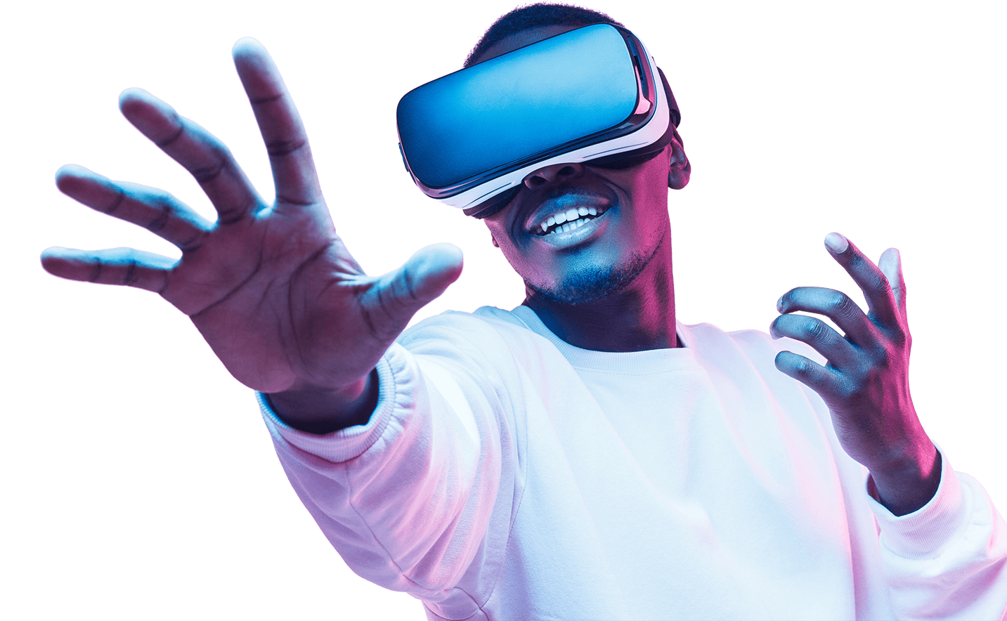
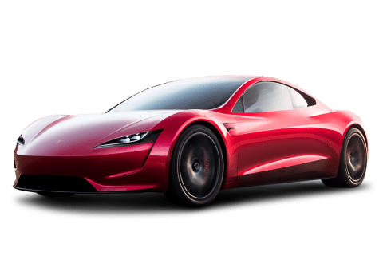
Driver Attentiveness in Virtual Reality
Professional Project (COM3001)
Student: James Wright
Supervisor: Dr. Steve Wesemeyer

Slide 2
Key terms
Attentiveness - the action of paying close attention to something.
Virtual Reality Simulation – the use of 3D objects and environments to create immersive and engaging experiences.
Project Aim – the focus & content of the work.
Objectives – a set of tasks that help fulfil the aim.
Task – a single item that needs to be accomplished.
Milestone – Marker or goal that you want to achieve for a list of tasks.

Slide 3
Project aim
The aim of the project is to investigate how different scenarios can positively or negatively effect a driver’s reaction time whilst driving a car.
On average 5 people die on the road per day in Great Britain, this project aims to provide research that can help to reduce that number.

Slide 4
Project Aim
This data can potentially be used in two ways:
To fuel government regulations (For example: banning the use of devices – such as handsfree phones)
To encourage new software or hardware for cars to be invented. If developers see data that suggests a technique works (For example: a red light appearing whenever a car in front slows down) then companies will be more likely to fund a project to create that technology.

Slide 5
Objectives
Create a 3D environment within Unity, using a combination of premade 3D assets and 3D objects created by myself within 3D design software (Maya).
Design and choose an art style for the 3D environment. Could be simple block shapes (more cartoony but easier to program & build) or be realistic (more difficult but may improve results).
Review literature pertaining to different studies in the same field, as well as the data on the various causes of crashes so that the test can be relevant.
Decide what the main features are that need to be implemented in the test. These can be to potentially distract the driver, to try and improve the drivers focus, or to impair the driver in some way (For example: handsfree phones, noisy passengers, relaxing music, loud music, visual indicators, visual impairment, etc.)
Research how to build different scenes within Unity (for creating different simulations) and connect each scene together into a full application that can be used for testing purposes with Virtual Reality hardware.

Slide 6
Objectives
Program a functioning application that can be used for experiments to gather quantitative results (For example: reaction times, crash rate, questionnaire values, etc.)
Test the program, and fix any major bugs.
Organise and perform live experiments using the software with various participating people. I will need to advertise the test properly and carry it out in an organised way where it is done efficiently and fairly.
Analyse the testing data and figure out what conclusions can be taken, whether the results are as expected, as well as any critiques/errors that could be done better in the future.

Slide 7
Example VR simulation:
Weather: Sunny.
Time: Midday.
Distraction: Loud music in car.
Scenario: Car in front of you slams on their brakes.
Input: Single button press to emergency stop the user’s car.
Resulting Data 1: User reaction time (in seconds) to the car emergency stopping.
Resulting Data 2: Boolean value (true/false) on if the user would have crashed into the car or not, based on stopping distance (in the simulation’s weather condition) & the user reaction time.

Slide 8
Tasks & Milestones
Task/Milestone | Start date | End date | Duration (in days)
Brainstorm Ideas | 09/10/2019 | 23/10/2019 | 11
Create Project Outline, Aims & Objectives | 16/10/2019 | 01/11/2019 | 13
Project Idea Chosen | 01/11/2019 | 01/11/2019 | *
Do Literature Review & Presentation Preparation | 01/11/2019 | 14/11/2019 | 10
Project Aims, Objectives & Milestones complete | 08/11/2019 | 08/11/2019 | *
Setup Unity Project & GitHub Repository | 08/11/2019 | 11/11/2019 | 2
Perform Mock Interim Discussion | 14/11/2019 | 14/11/2019 | *
Interim Discussion Preparation | 14/11/2019 | 29/11/2019 | 12
Key Design (UML diagrams, sketches, etc.) | 22/11/2019 | 06/12/2019 | 11
Title | Start date | End date | Duration (in days)
Brainstorm Ideas | 10/09/2019 | 10/23/2019 | 11
Create Project Outline, Aims & Objectives | 10/16/2019 | 11/01/2019 | 13
Project Idea Chosen | 11/01/2019 | 11/01/2019 | -
Do Literature Review & Presentation Preparation | 11/01/2019 | 11/14/2019 | 10
Project Aims, Objectives & Milestones complete | 11/08/2019 | 11/08/2019 | -
Setup Unity Project & GitHub Repository | 11/08/2019 | 11/11/2019 | 2
Perform Mock Interim Discussion | 11/14/2019 | 11/14/2019 | -
Interim Discussion Preparation | 11/14/2019 | 11/29/2019 | 12
Key Design (UML diagrams, sketches, etc.) | 11/22/2019 | 12/06/2019 | 11
Interim Discussion Presentation | 11/29/2019 | 11/29/2019 | -
Create and acquire the main 3D models needed | 11/29/2019 | 12/20/2019 | 16
Coding in Unity | 11/29/2019 | 04/24/2020 | 106
Main Object programming & scripts complete | 01/10/2020 | 01/10/2020 | -
Prepare for Alpha test (practice experiment) & bug fixing | 01/10/2020 | 01/31/2020 | 16
Create Feedback Forms | 01/17/2020 | 01/31/2020 | 11
Alpha Test | 01/31/2020 | 01/31/2020 | -
Adapt/Fix Experiment & Application based on feedback | 02/03/2020 | 03/06/2020 | 25
Book room & time-slots for Experiment | 03/06/2020 | 03/09/2020 | 2
Advertise main experiment and book people | 03/09/2020 | 03/18/2020 | 8
Main Experiment (Beta) | 03/18/2020 | 03/18/2020 | -
Record Results into tables & graphs | 03/18/2020 | 03/23/2020 | 4
Draft Report Submission | 03/24/2020 | 03/24/2020 | -
Code finalised | 04/24/2020 | 04/24/2020 | -
Window for Additional Testing & Data Collection | 04/24/2020 | 05/15/2020 | 16
Final Draft of Dissertation | 05/15/2020 | 05/15/2020 | -
Final Submission | 05/26/2020 | 05/26/2020 | -
*milestone

Slide 9
Tasks & Milestones
Task/Milestone | Start date | End date | Duration (in days)
Interim Discussion Presentation | 29/11/2019 | 29/11/2019 | *
Create and acquire the main 3D models needed | 29/11/2019 | 20/12/2019 | 16
Coding in Unity | 29/11/2019 | 24/04/2020 | 106
Main Object programming & scripts complete | 10/01/2020 | 10/01/2020 | *
Prepare for Alpha test (practice experiment) & bug fixing | 10/01/2020 | 31/01/2020 | 16
Create Feedback Forms | 17/01/2020 | 31/01/2020 | 11
Alpha Test | 31/01/2020 | 31/01/2020 | *
Adapt/Fix Experiment & Application based on feedback | 03/02/2020 | 06/03/2020 | 25
Book room & time-slots for Experiment | 06/03/2020 | 09/03/2020 | 2
*milestone

Slide 10
Tasks & Milestones
Task/Milestone | Start date | End date | Duration (in days)
Advertise main experiment and book people | 09/03/2020 | 18/03/2020 | 8
Main Experiment (Beta) | 18/03/2020 | 18/03/2020 | *
Record Results into tables & graphs | 18/03/2020 | 23/03/2020 | 4
Draft Report Submission | 24/03/2020 | 24/03/2020 | *
Code finalised | 24/04/2020 | 24/04/2020 | *
Window for Additional Testing & Data Collection | 24/04/2020 | 15/05/2020 | 16
Final Draft of Dissertation | 15/05/2020 | 15/05/2020 | *
Final Submission | 26/05/2020 | 26/05/2020 | *
*milestone

Slide 11
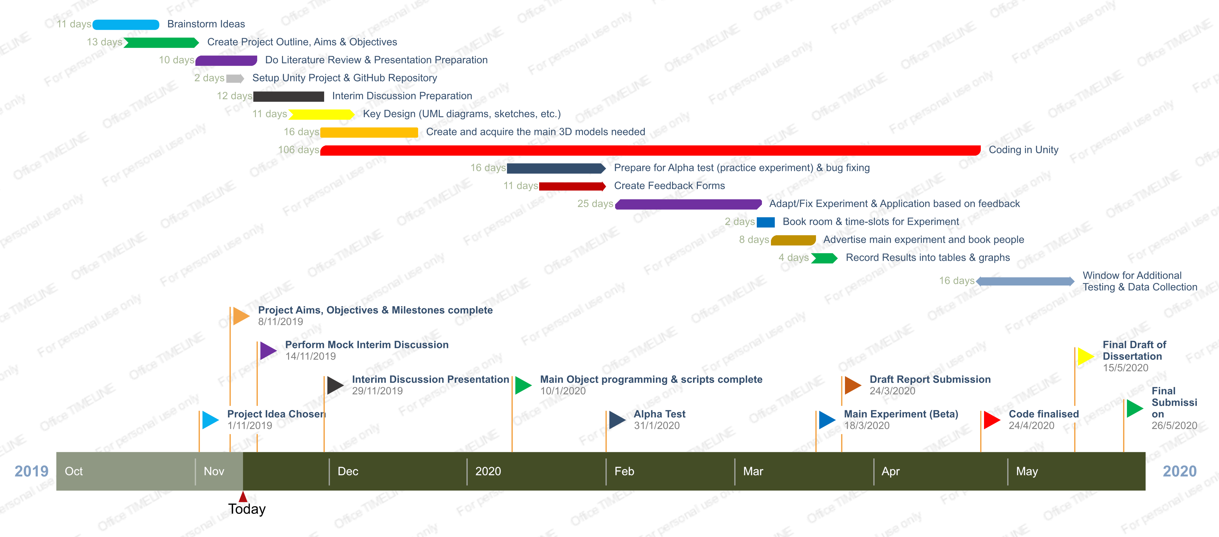
Tasks & Milestones
*Timeline created using Office Timeline free online version (https://www.officetimeline.com/download)

Slide 12
Literature Review: Road Accidents/Fatalities
On average, in Great Britain, 5 people die per day on the road and many more are injured [1]. There are many different determining factors in these accidents that need to be explored, what are the main causes of road accidents and what percentage of those is the driver at fault? See [2], where speeding and distractions (both areas that can be easily explored in this project) make up nearly 50% of the causes of fatalities on the road. This is the area that needs to be focused on, because the aim of the project is to provide more data into what could potentially cause a driver to have an accident and data into what technology could potentially prevent a driver from causing an accident.
A list of the various reported causes of road traffic accidents [3] lists “driver failed to look properly” as the number 1 reported cause, which is not something that can be easily fixed with software/hardware (apart from self-driving vehicles). However, number 2 is “driver failed to judge the other persons path or speed” which is something that can be very easily tested within this project, and there is high potential for hardware feasibly being able to fix this problem. For example: in the project I could simulate two different scenes – one where there is no indicator of the car in front slowing down, and another where there is an audio (beep) and visual (red light) stimulus for when the car in front is slowing down significantly – then check how quickly the test subject reacted to the car in front slowing down for both scenarios. If there is a significant improvement with reaction times and braking times with the audio and visual stimulus then there is good evidence to suggest that if a company created that technology it would reduce road traffic accidents, as that is the number 2 reported cause.

Slide 13
Literature Review: Road Accidents/Fatalities
In regards to other variables to look out for, see [4] where fatigue is focused as a large potential source of accidents in general (including driving accidents). It notes that variables that could be the key cause of fatigue: age, sex, race, socio-economic status, and marital status – are mainly used as descriptive terms (independent of the study) rather than confounding ones. They recommend to record this demographic data of subjects and include these variables within the datasets to help with future research. Further data [5] suggests that you are three more times likely to be in a car crash if you are fatigued and that driver reaction times, awareness of hazards, and general attentiveness is worsened by driver fatigue.
A previous driving virtual reality simulation study was done [6] on subjective risks of driving behaviour – it found that the risk perception of the driver in a specific driving scenario is a key factor in whether they will crash or not. Independent of driver skill, those who crashed were more confident in their success of correctly performing a difficult manoeuvre, hence chose to try and drive through tighter gaps, than those who did not crash.

Slide 14
Literature Review: Virtual Reality
Some users report to have motion sickness (nausea), loss of spatial awareness, and/or dizziness while using Virtual Reality devices. To quote [8] “The makers of the most popular VR headsets, the Oculus Rift and HTC Vive, recommend taking at least a 10 to 15-minute break every 30 minutes, even if you don’t think you need it”. Hence, I should be tracking the time that each participant takes and make sure that I design the experimental simulations to last less than 30 minutes per person (For example: Three 5-minute simulations, with a minute in between) in order to lower the risk of a subject getting sick due to my experiment. A project [7] on a motion sickness measurement index in a virtual reality environment developed a Virtual Reality Sickness Questionnaire (VRSQ), a variant on a Simulation Sickness Questionnaire (SSQ), which could be used in testing to check whether my application consistently makes users feel ill or not (as that could definitely become an unwanted factor on the results). Also see [9] where the study suggests women in particular are affected by motion sickness in the oculus rift more than men are – another factor to take into account. [11] lists the potential causes of motion sickness within virtual reality experiences, and suggests potential solutions including: ambisonic sound to match the sense of movement, letting users rest between scenes, adding rest frames (fixation points) for users to be able to focus on, reducing virtual rotations, and reducing angular velocity. The majority of these concepts can be applied to my project and should be considered when designing the application.
Another factor that could affect the results of the project is whether a dangerous situation (potential car crash) is treated as a serious situation within a virtual reality environment. A study on psychological responses to an emergency in virtual reality [10] suggests “a virtual emergency can be staged in a virtual environment since users would acknowledge it as such” from their results, which adds credibility to any potential results I get from my experiment. The study also goes into racial discrimination in a virtual reality situation but that is not relevant to my project.

Slide 15
Literature Review: References
[1] https://www.brake.org.uk/facts-resources/1653-uk-road-casualties - Brake UK 2017 report on road casualties.
[2] https://www.aceable.com/safe-driving/car-accident-statistics/ - Aceable US driving fatality data (2007 – 2012).
[3] https://www.regtransfers.co.uk/content/common-causes-for-road-accidents-in-britain/ - latest statistic from the department of transport (in Britain) for the most common causes of road traffic accidents (published 2nd July 2018).
[4] https://www.sciencedirect.com/science/article/pii/S0001457509003327 - Accident Analysis & Prevention (Volume 43, Issue 2, March 2011, Pages 516-532)
[5] https://www.nsc.org/road-safety/safety-topics/fatigued-driving#:~:targetText=A%20study%20by%20the%20AAA,times%20the%20police%2Dreported%20number.&targetText=NHTSA%20estimates%20fatigue%2Drelated%20crashes,annually%2C%20not%20including%20property%20damage. – National Safety Council article on “drowsy driving” (2019)
[6] https://www.sciencedirect.com/science/article/pii/S0001457513003497?via%3Dihub - Accident Analysis & Prevention (Volume 62, January 2014, Pages 63-78)
[7] https://www.sciencedirect.com/science/article/pii/S000368701730282X - Applied Ergonomics (Volume 69, May 2018, Pages 66-73)
[8] https://www.businessinsider.com/virtual-reality-vr-side-effects-2018-3?r=US&IR=T#loss-of-spatial-awareness-1 – Business Insider “Here's what happens to your body when you've been in virtual reality for too long” by Kaylee Fagan (Mar 4, 2018, 4:00 PM)
[9] https://search.proquest.com/docview/1877838144?accountid=17256&rfr_id=info%3Axri%2Fsid%3Aprimo - Experimental Brain Research (Volume 235, Issue 3, Pages 889-901)
[10] https://www.sciencedirect.com/science/article/pii/S0747563215000540?via%3Dihub - Computers in Human Behavior (Volume 48, July 2015, Pages 104-113)
[11] https://uxplanet.org/motion-sickness-in-vr-3fa8a78216e2 - Motion Sickness in VR by Anastasiia Ku (Nov 29, 2018)

Slide 16
Literature Review: Key Points
On average, in Great Britain, 5 people die per day on the road and many more are injured. With the majority of the fatally injured being drivers & passengers [1].
Speeding and Distractions make up nearly 50% of the named causes for road fatalities [2].
Demographic data for subjects should be recorded (age, sex, race, economic status, etc.) as from previous similar studies it suggested these variables may be an important factor in fatigue [4] hence accident likelihood of a subject [5].
Risk perception of the driver is a key factor in whether they will crash or not, independent of driver skill [6] – implying driving skill is not a significant factor, the overconfidence of a driver is.
Virtual Reality Sickness Questionnaire (VRSQ) or a Simulation Sickness Questionnaire (SSQ) can be used to measure motion sickness when testing [7] – recommended to minimise motion sickness in the final build of the application.
Maximum of 30 minutes of virtual reality simulation per person recommended to minimise motion sickness [8] (along with other similar information in [9], [11], to minimise motion sickness in VR)
“a virtual emergency can be staged in a virtual environment since users would acknowledge it as such” [10] – this whole study adds credibility that the results from my experiment will be reliable, as they conclude that users treat virtual situations seriously. Hence, they will try and react correctly & as fast as possible in a “dangerous” situation (car accident in this context).

Slide 17



Software
GitHub: (Free Version)
For file management, version control, and backups.
Unity 3D: (Free Version)
For creating & scripting 3d environments & scenes – the main application.
Autodesk Maya: (Student Version - Free)
For creating realistic 3D models that can be textured, animated, & used as an asset within unity. It is industry standard.

Slide 18
Progress so far:
Setup Unity Project with GitHub (made sure only the appropriate files are committed too).
Drafts of Aims, Objectives, and Literature Review completed.
Milestones and basic timeline complete (plus to-do list for specific tasks).
Basic design decisions made, however some still need to be figured out (what inputs will the user be in control of? Art style? Recognising threats or reacting to them? etc).
Tutorials for basic 3D modelling within Maya started.
References for literature and for code (so far) recorded within documents.

Slide 19

Thank you for listening! Any Questions?

